Slide 1
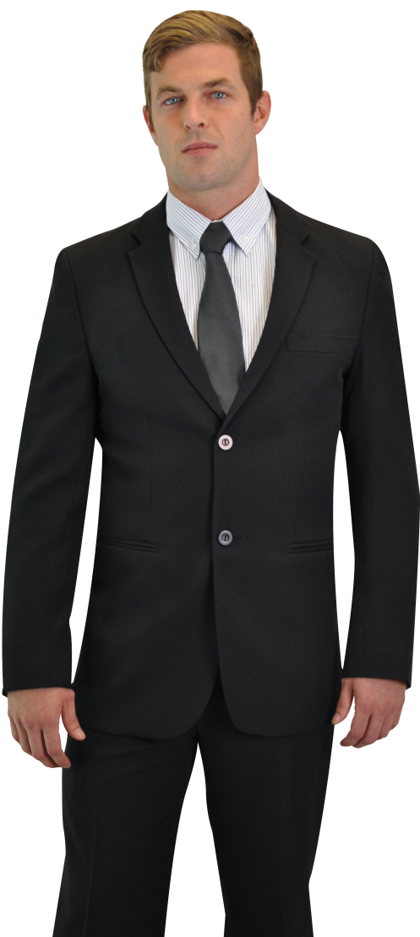
HOTEL & CASINO STAFF UNIFORMS

